Slide 1
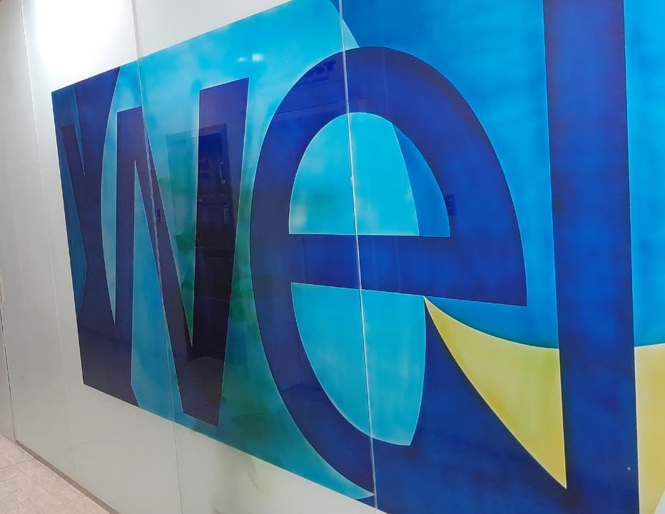

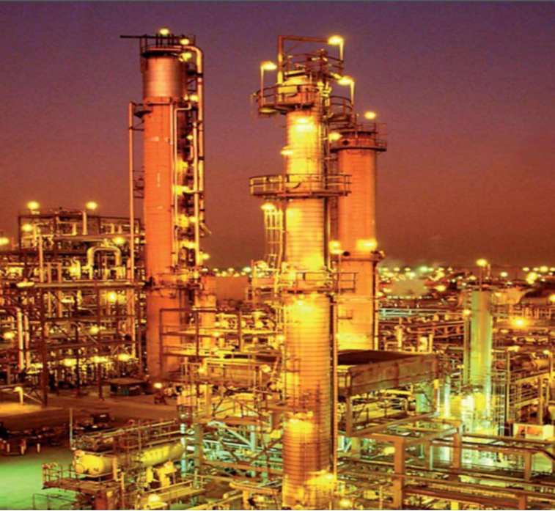

WellCare Trading & Contracting Est.
ABOUT US
Material Supply
Instrument
Electrical equipment
Metals
Tools
Safety Equipment
Chemicals
Medical Supplies
WellCare is committed to support most of oil, gas, petrochemical, electrical, salina water and ABC contract companies in Saudi Arabia and other Gulf country by supplying their martial requirements with high quality, competitive price & best delivery time.
We as WellCare management have the capability to fulfill our end-user demand around the clock.
We have established our material forecast department to re-sources most frequent T&I (Testing, Inspection & shutdown requirement) requirement ahead of time by doing this we are reducing the shutdown period which will result in less cost in our end-user budget.
WellCare Services
Mechanical
Electrical
T&I support
Security & IT Services
Heavy Equipment
WellCare Website

Slide 2

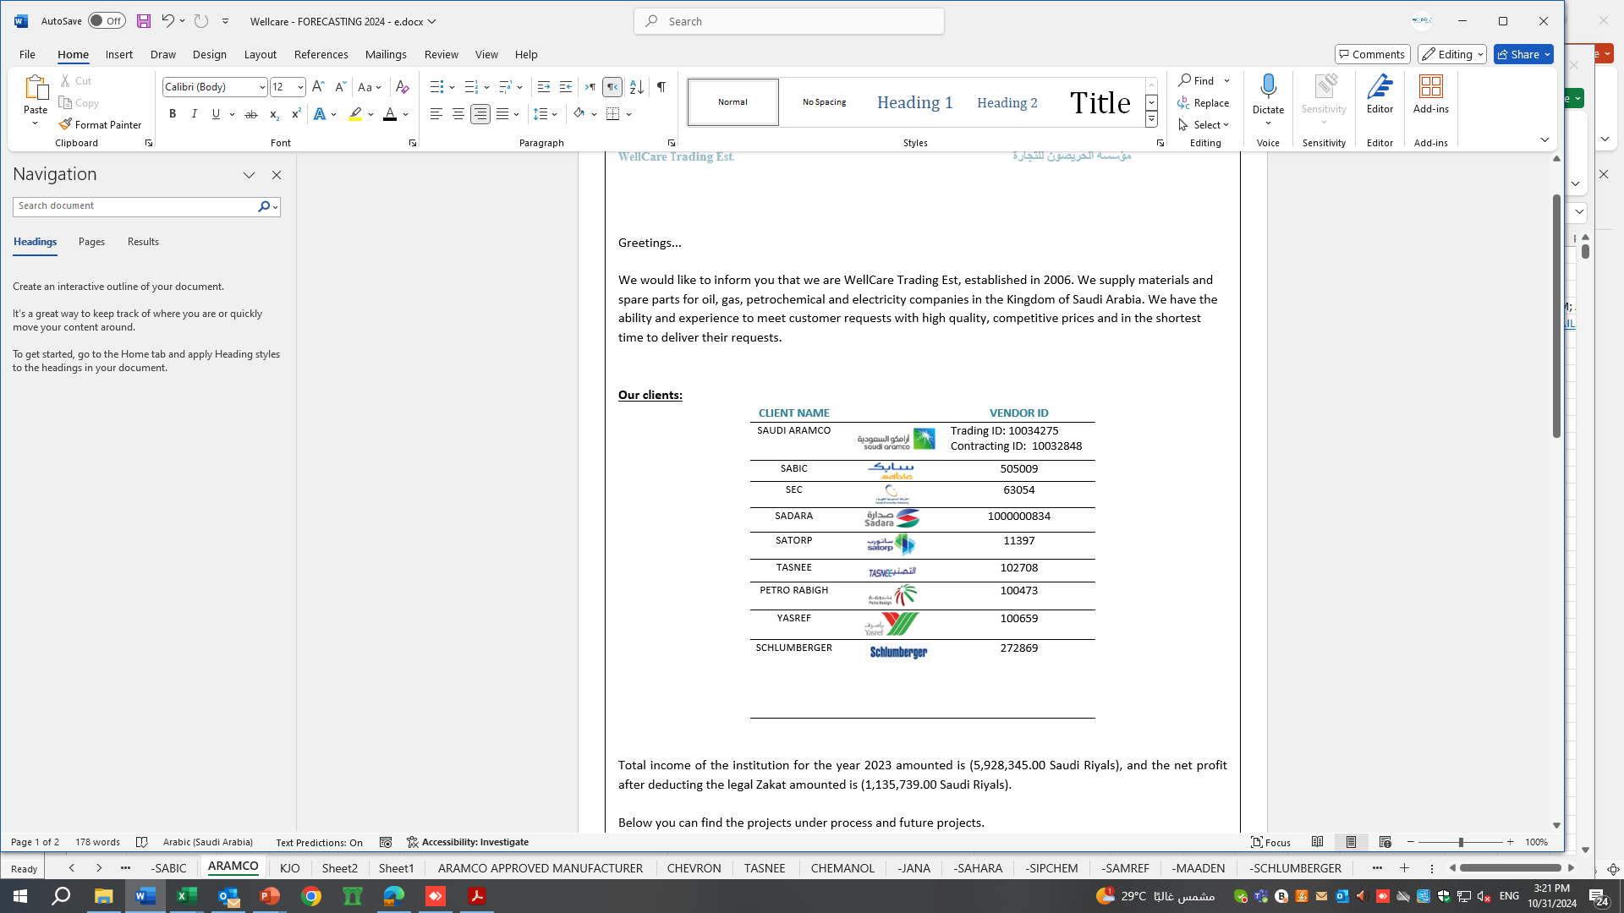
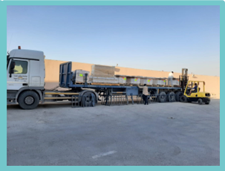
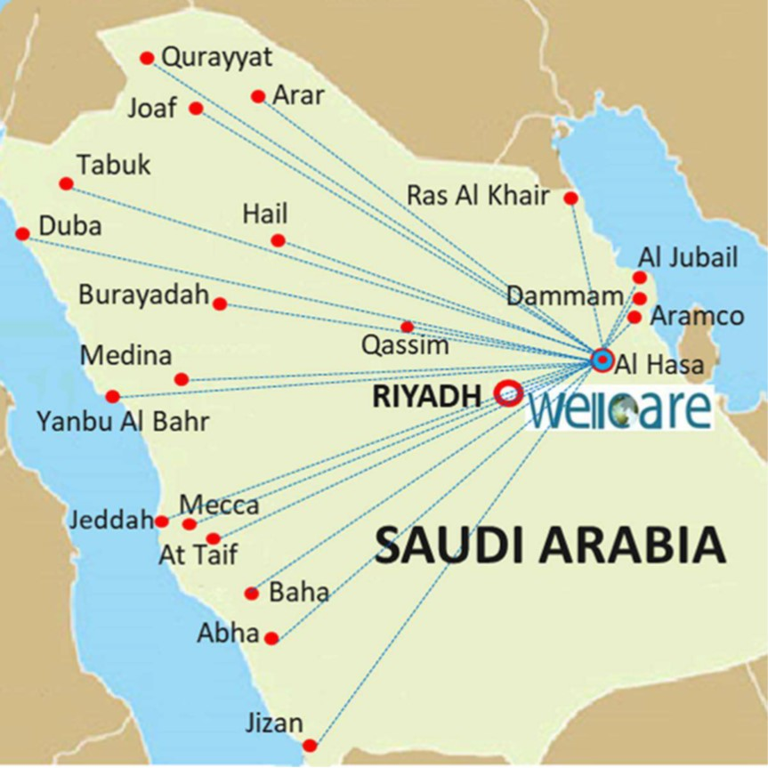

Customers
our location
Welcome to WELLCARE, a leading trading company located in AlHasa, Saudi Arabia. With a strong focus on quality and customer satisfaction, we strive to provide the best products and services to our clients.
CONTACT US
Dhahran Street Al-Hasa Mubarraz
P.O Box: 4800, Hofuf: 31982,
Kingdom of Saudi Arabia
Tel: +966 013 531194
Mobile: +966 555 825476
Fax: +966 013 5311943
Email: sales@wellcare.com.sa
WEB: www.wellcare.com.sa
WellCare location

